Slide 1
classifying Tickets to Appropriate Category and Subcategories
Kalpa subbaiah
Supratim
SAIKIRAN

Slide 2
BUSINESS PROBLEM
Lifeline Health Services tickets have the details of Summary and Description of the calls written by various staff members with no standard text guidelines. The challenge is, based on the Summary and Description of the call written in ͞converse͟ column, the ticket is to be classified to Appropriate Category and Subcategories

Slide 3
METHODOLOGY
Deep Learning Algorithms:
MLP
CNN
RNN-LSTM
Performance Metrics:
Accuracy
Recall

Slide 4
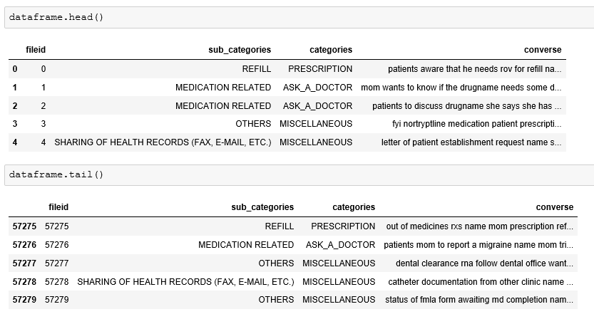
DATA SOURCE

Slide 5
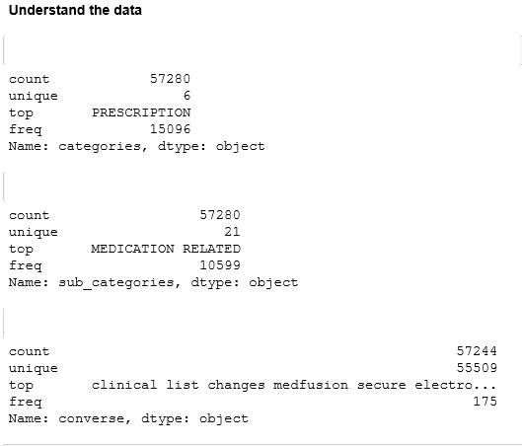
Data Understanding

Slide 6
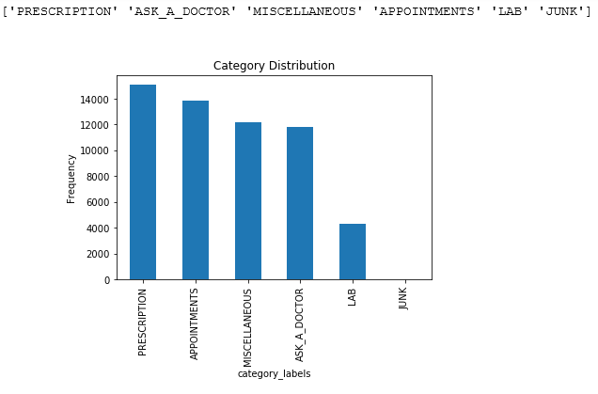
Data Understanding

Slide 7
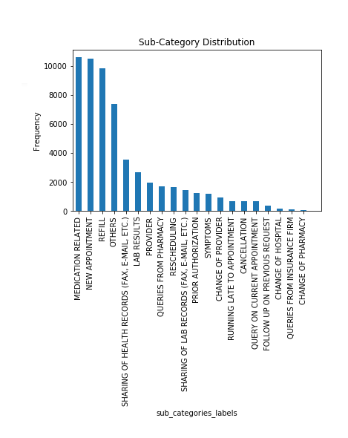
Data Understanding

Slide 8
Methodology
Data Preprocessing:
Remove NAN’s
Remove Stopwords
Stemming
Strip Whitespaces
Word Embedding –Glove
vectorize the text samples into a 2D integer tensor- tokenizer
dictionary mapping label name to numeric id (LabelEncoder.transform)
One hot encoding of labels
Applied modeling
Evaluated using confusion metrics

Slide 9
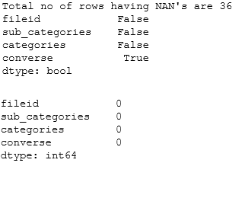
Removed NAN’s

Slide 10
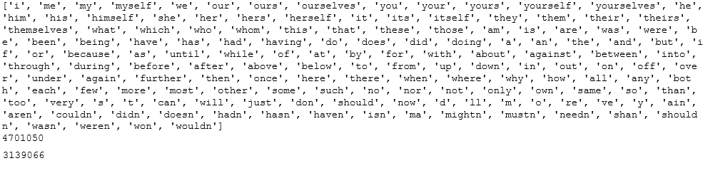
Removed Stopwords

Slide 11
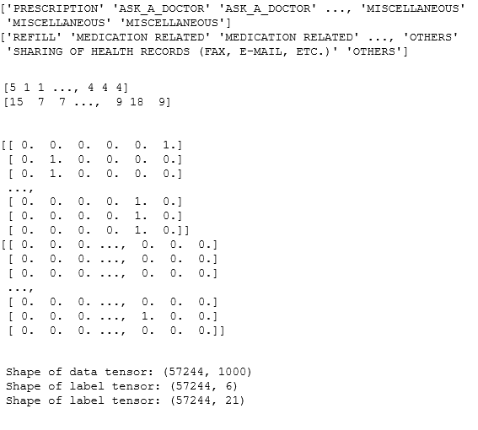
Data Transform

Slide 12
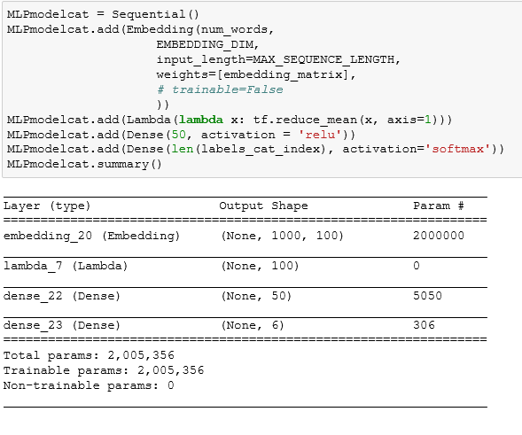
MLP Model

Slide 13
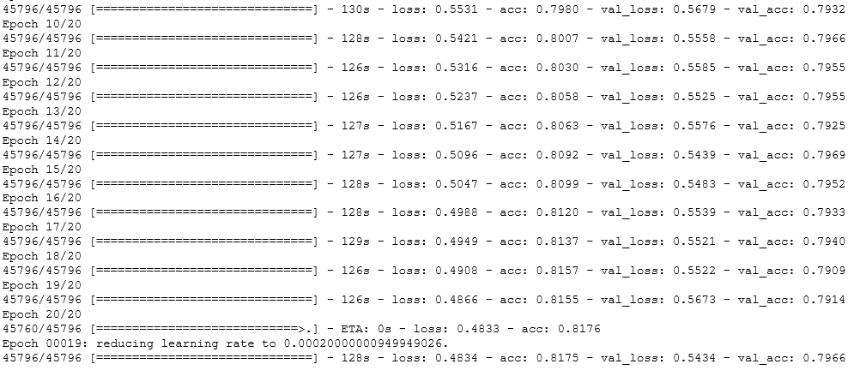
MLP CategorY Result

Slide 14
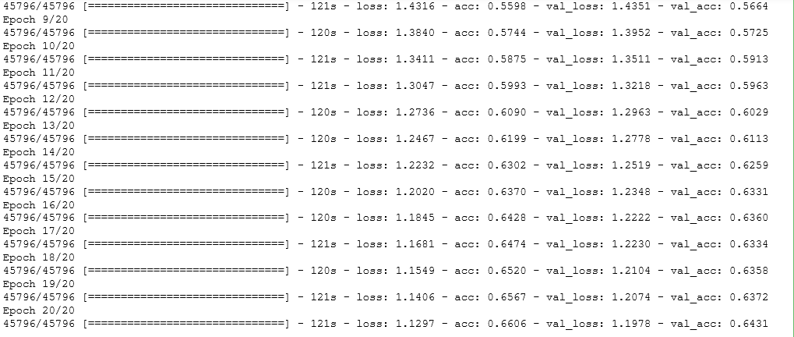
MLP Sub-Category Result

Slide 15
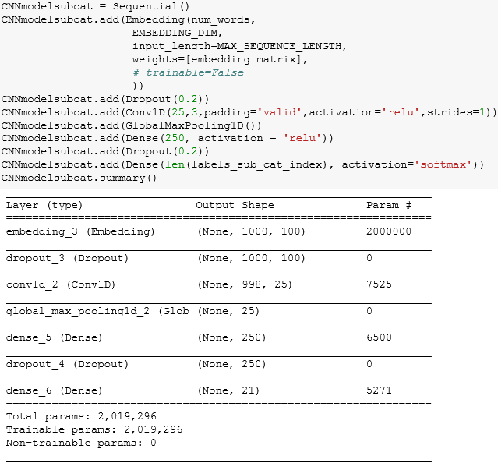
CNN Model

Slide 16
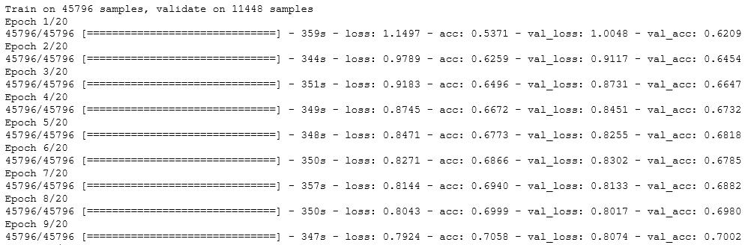
CNN CategorY Result

Slide 17
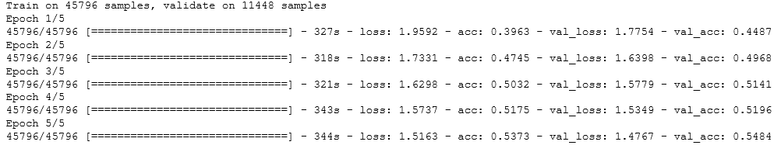
CNN Sub-Category Result

Slide 18
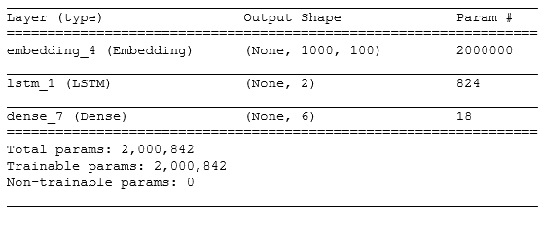
RNN Model

Slide 19
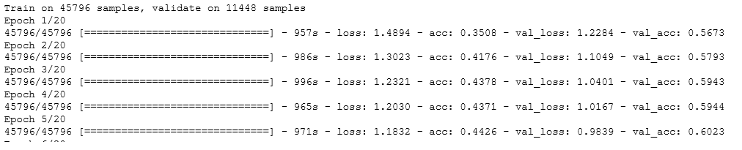
RNN Category Result

Slide 20
Evaluation Metrics Comparison
MODEL | Category Accuracy | Subcategory Accuracy
MLP | 0.7966 | 0.6431
CNN | 0.7002 | 0.6484
RNN | 0.6023 | 0.6001

Slide 21
Q & A

Slide 22
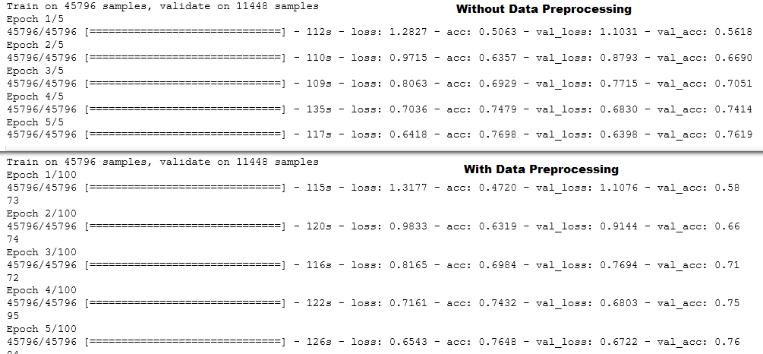
Data Preprocessing Required

